Slide 1
The Coffee Shop @SaFaVi
Web Application Architecture
Prof. Bruen

Slide 2
Techniques
Spring Tiles
Spring Validation
Spring Security
Spring Data JPA
Localization
REST/AJAX
Exception Handler
HTTP Multipart Request (file upload)
Github

Slide 3
Features
Product Management
Product Category Management
Order Management
User Management – Registration
Authentication - Authorization

Slide 4
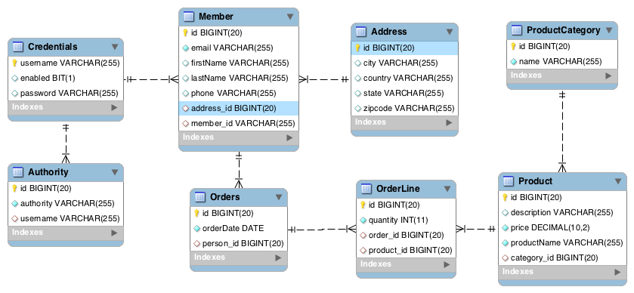
Database Design

Slide 5
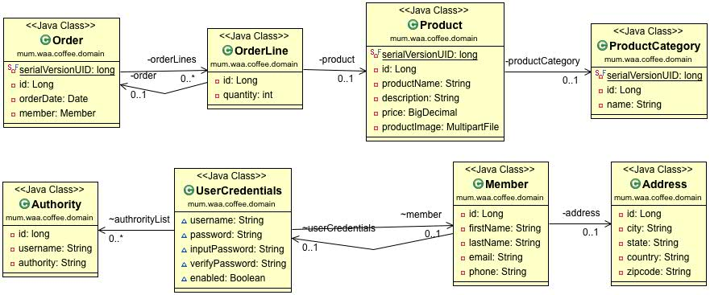
Domain Class Diagram

Slide 6
PowerPoint 2013
Intuitively design beautiful presentations, easily share and work together with others and give a professional performance with advanced presenting tools.
Find out more at the PowerPoint Getting Started Center
(Click the arrow when in Slide Show mode)
Notes:
In Slide Show mode, click the arrow to enter the PowerPoint Getting Started Center.

